Slide 1
Introduction to MapReduce

Slide 2
MapReduce
MapReduce is a parallel programming framework designed for processing large data sets.
Makes parallel programming easy
Before going into detail regarding MapReduce
Let us consider some different example problems and see if parallel programming is actually useful or not
It turns out there are many problems that do not benefit much at all from parallel programming
Therefore MapReduce is of little help for solving these problems.

Slide 3
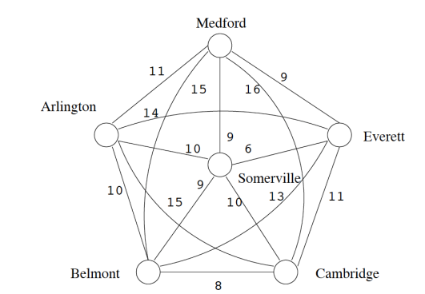
Example Problems 1: Traveling Salesman
Find a cycle in the graph such that
each vertex is only visited once
the sum of the weights are minimized

Slide 4
Example Problems 1: Traveling Salesman
This problem is an instance of an NP-complete problem.
There are no known polynomial time solutions to any NP-complete problems.
If you are interested please look up NP-complete
This means the complexity of this problem is exponential. In this particular case the solution is in the order of O(n!)
Meaning we need to try every possible combination to find the answer.
For this type of problem parallel programing has negligible effect.
No one can solve this using any existing computer or all the computers in the world connected, if the program size is moderately large
For example if there are 100 graph nodes (n = 100) then it would take around 9.33x 10¹⁵⁷ operations
So if you used 1000 computers then you can reduce the above complexity to
9.33 x 10¹⁵⁴ operations parallelism will not help much

Slide 5
Parallel Programming Not Suitable for high complexity problems
Parallel programming is not suitable for solving problems that have high complexity.
We saw the traveling salesman problem is NP-complete
There are many other problems that are NP-complete
Need to find some heuristic solution.
Find a near optimal answer.
Other high complexity problems which are not as hard as NP-complete also maybe too hard for parallel programming (e.g. has complexity of O(n¹⁰))
For these problems we need to find better algorithms or live with non-optimal answer

Slide 6
Example Problem 2: Search
Find all occurrences of the word La Trobe in a collection of 10 million documents (100 GB)
Can parallel programming help us solve this problem?
The answer depends
Is there already an index on the data?
If index exists then
No need to use parallel programming
Just use one computer to lookup solution
LaTrobe

Slide 7
Example Problem 2: Search
If no index exists and data is not sorted then
Yes parallel programming can help
Give each computer a subset of the 100 million documents to search through
Each computer reports its results

Slide 8
Search
Parallel programming is not useful for
Searching for one thing in an index
Parallel programming is good for exhaustive search
Need to touch every bit of data to find something
Another situation
Searching through sorted data
Do not need parallel programming since we can do binary search in log (n) time.

Slide 9
Example Problem 3: Data Transformation
You are given 100 million documents and you are asked to compress the documents using the following dictionary table by replacing each word with its code word.
Replacing each word with its code word compresses each document since the code word takes a lot less space to store.
This problem is very suitable for parallel programming
word | Code word
Banana | 001
Carrot | 002
… | …
… | …
… | …
Zukini | 102

Slide 10
Example Problem 3: Data Transformation
Map
Each machine takes a subset of the 100 million documents and uses their own copy of the dictionary to produce compressed versions of the documents.
Maps input documents to compressed documents

Slide 11
Example Problem 4: Data Transformation
Suppose you are given 100 million mp3 files and you need to convert each file into WMA files
Parallel programming loves this problem
Maps each mp3 file into a WMA file
Map

Slide 12
Data Transform
Parallel programming is good at applying an independent transformation on each separate piece of data.

Slide 13
Example Problem 5: Aggregation
You are given 100 million documents, and you are asked to count the number of occurrences of each word in the document.
We need to perform aggregation since the separate occurrences of the different words need to be combined together.
This is a problem well suited to parallel programming.

Slide 14
Example Problem 5: Aggregation
Extract individual words and send to aggregator machines based on hash value of word
Map
All occurrences of same word end up at the same aggregator machine.
Reduce
ice bolt rock computer ice rock rock
ice 2 bolt 1 computer 1 rock 3

Slide 15
Example Problem 5: Aggregation
Extract individual words and send to aggregator machines based on hash value of word
Map
All occurrences of same word end up at the same aggregator machine.
Reduce
Each of the top level machines extract the individual words and send them to a separate set of aggregator machines
Use hash function to determine which aggregator machine to send data to.
All occurrences of the same word end up at the same aggregator machine.
Aggregator machines can then just add up all occurrences of the same word and then report it to the user.

Slide 16
Data Aggregation
Parallel programming is very useful for data aggregation of large data sets.
Need to combine many small pieces of data in some way to produce the desired output.

Slide 17
Do you see a pattern?
Parallel programming is really good for problems involving all data sets and you need to touch every piece of data for some reason.
We also need to be able to process the data independently.
The work that one machine does is independent of the other machines.

Slide 18
Parallel programming is hard
Although the problems described so far look easy to parallelize. Programming them over large networks of computers is hard.
Need to write program that can run on multiple computers
The program on each computer needs to
Know where to get the input data from
Know where to send intermediate data in the case of aggregation
Know where to write results
Need to handle failure
Failure very common on large clusters of computers.
Need to replicate data
When failure occurs
Find replicated data
Need to work out what to restart
etc

Slide 19
MapReduce
Key Idea
Allow programmer to write two sequential programs (map and reduce) that operate on one small piece of data at a time.
MapReduce framework will then apply these two sequential programs to massive data sets to automatically produce a parallel program.
Many small sequential programs run in parallel

